Slide 1
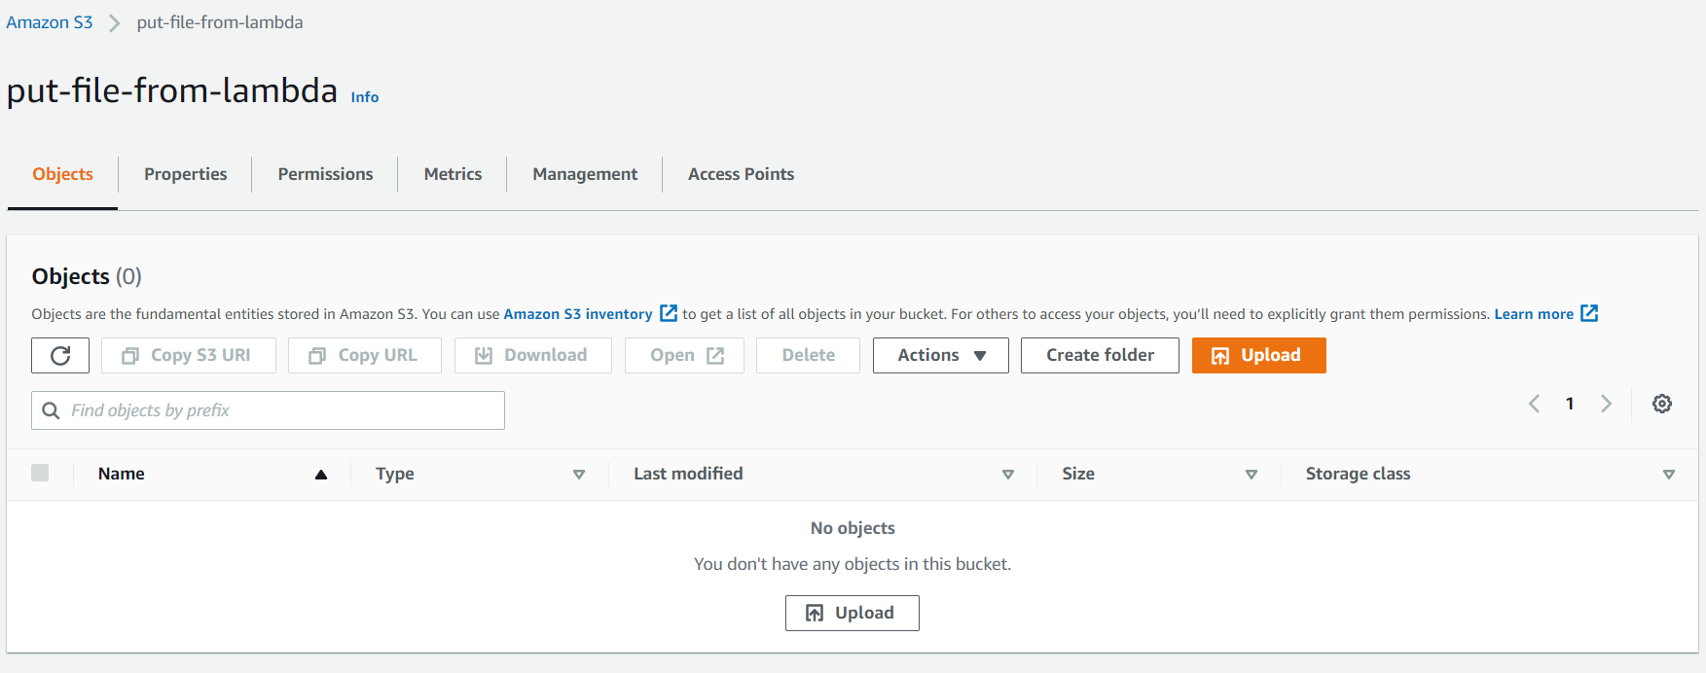
Created An Empty Bucket

Slide 2
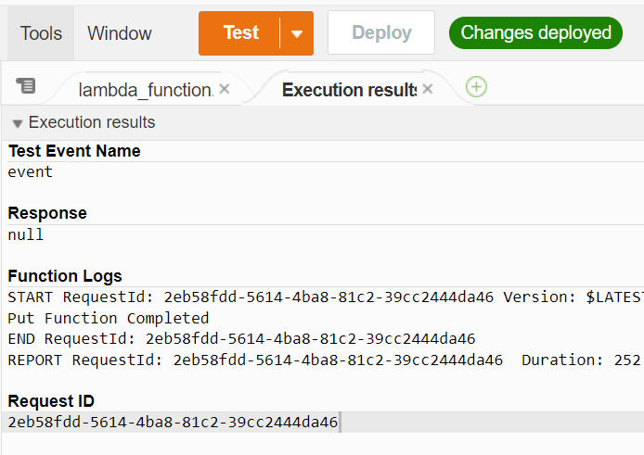
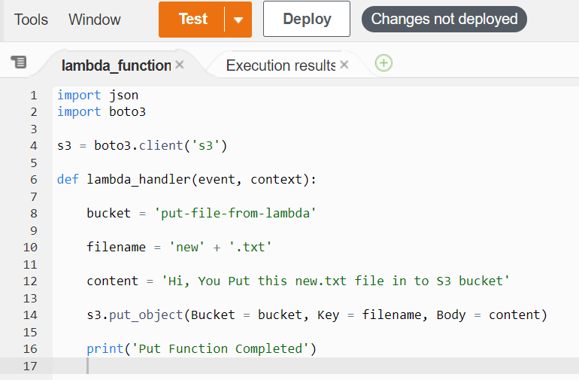
Python Code
Testing

Slide 3
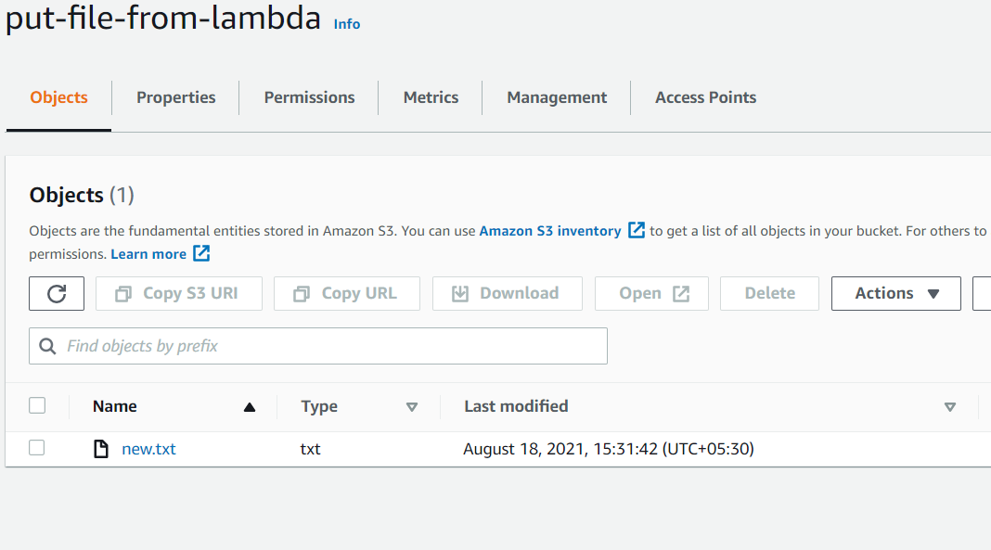
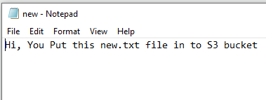
Result
Once code runs successfully, the new.txt file was added into the S3 bucket

Slide 4
Lambda Python Snippet
import json
import boto3
s3 = boto3.client('s3')
def lambda_handler(event, context):
bucket = 'put-file-from-lambda'
filename = 'new' + '.txt'
content = 'Hi, You Put this new.txt file in to S3 bucket'
s3.put_object(Bucket = bucket, Key = filename, Body = content)
print('Put Function Completed')

